Slide 1
TEMPLATE OF
GRAPHICAL
CHART
https://a.slack-edge.com/4d5bb/marketing/img/media-kit/slack_brand_guidelines_september2020.pdf
Example

Slide 2


LOGO
MAIN
VARIATIONS

Slide 3



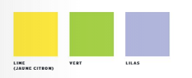
COLORS
MAIN
SECONDARY COLORS
TEXT COLOR

Slide 4

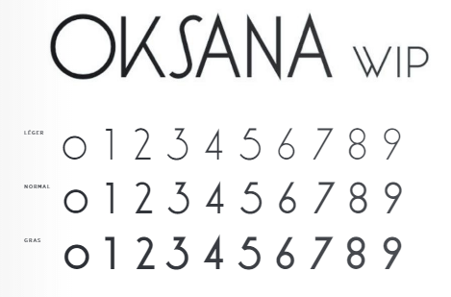
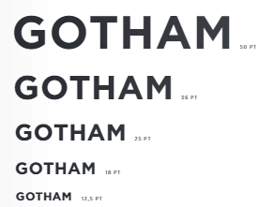
FONTS
MAIN
FONT FOR NUMBERS
POSSIBLE SIZES

Slide 5
LAYOUT
TITLE
MAIN PAGE
Left content
Right content
15
15
15

